Slide 1
Update on COVID 19 Therapeutics
Atul Kothari MD FIDSA
Elizabeth Woodland Borella MPH

Slide 2
Disclosures
None

Slide 3
Arkansas Department of Health
Mission Statement: To protect and improve the health and well-being of all Arkansans
Vision Statement: Optimal health for all Arkansans to achieve maximum personal, economic and social impact

Slide 4
Overview
Omicron Status
Pre Exposure Prophylaxis: Evusheld
Oral Antivirals
  Paxlovid
  Molnupiravir
Remdesivir
NIH Prioritization Guidelines
Operational Considerations

Slide 5
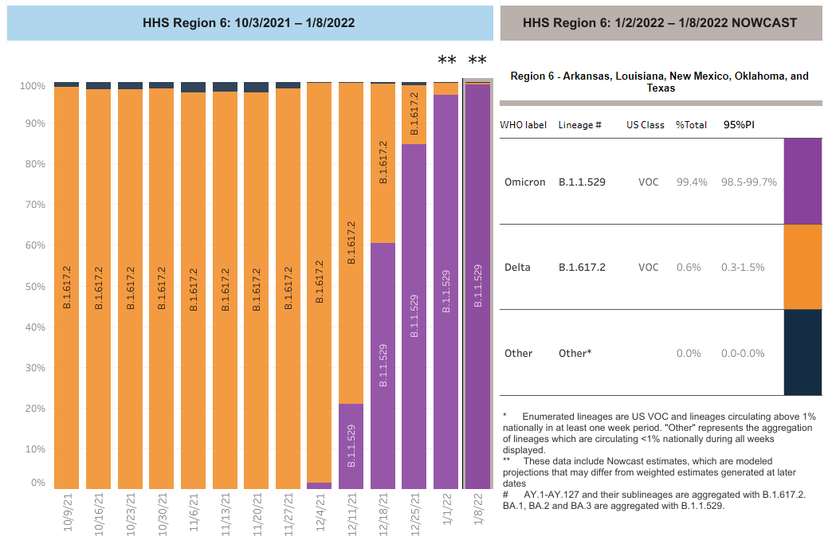
Omicron: Nowcast CDC

Slide 6
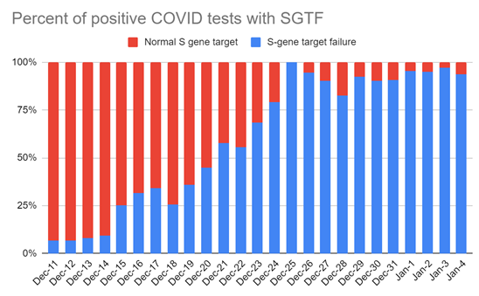
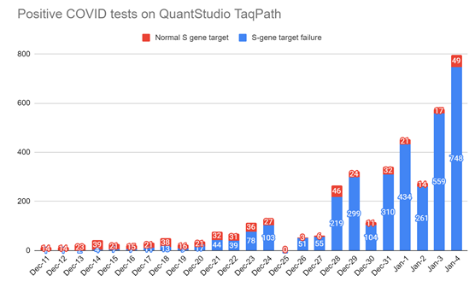
Omicron: SGTF Data
Dr Amanda Novack, Personal Communication

Slide 7
Impact of Omicron on Therapeutics
 | Pseudovirus Neutralization FOLD Reduction in Susceptibility
 | Delta | Omicron
Bamlanivimab/Etesevimab | No change | >2938 fold
Regen CoV | No change | >1014 fold
Sotrovimab | No change | No change
Updated FDA EUA

Slide 8
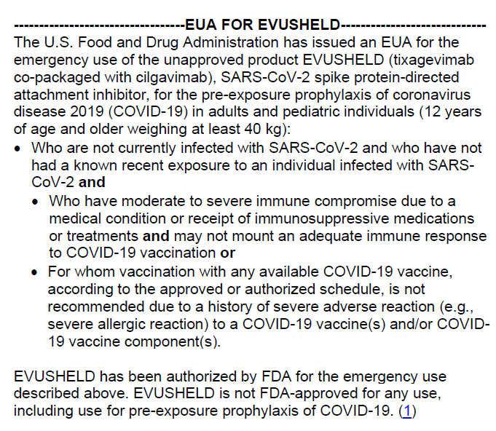
Evusheld (Tixagevimab/cilgavimab)

Slide 9
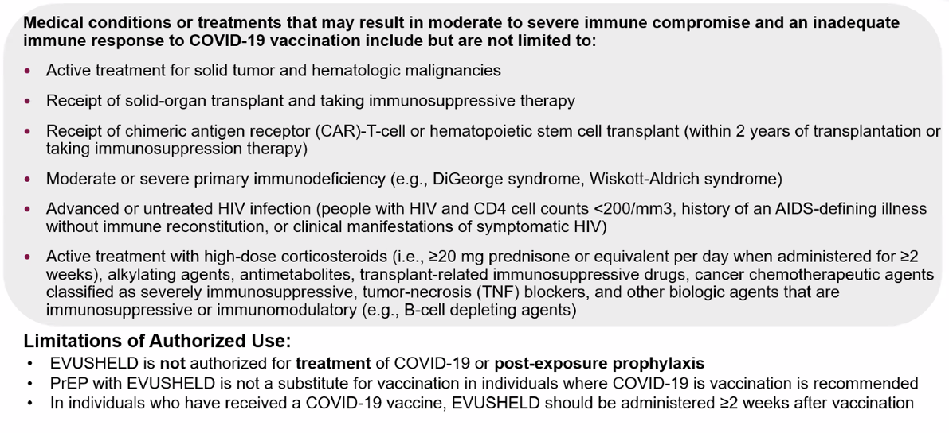
Medical Conditions/Treatments

Slide 10
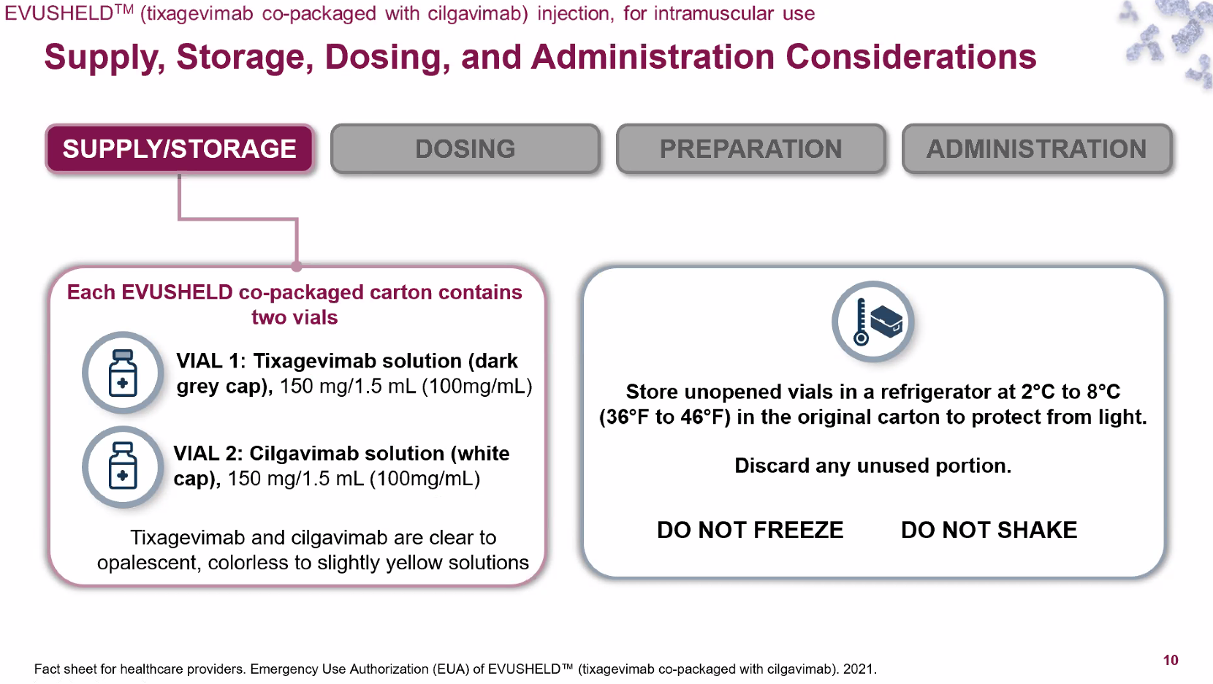
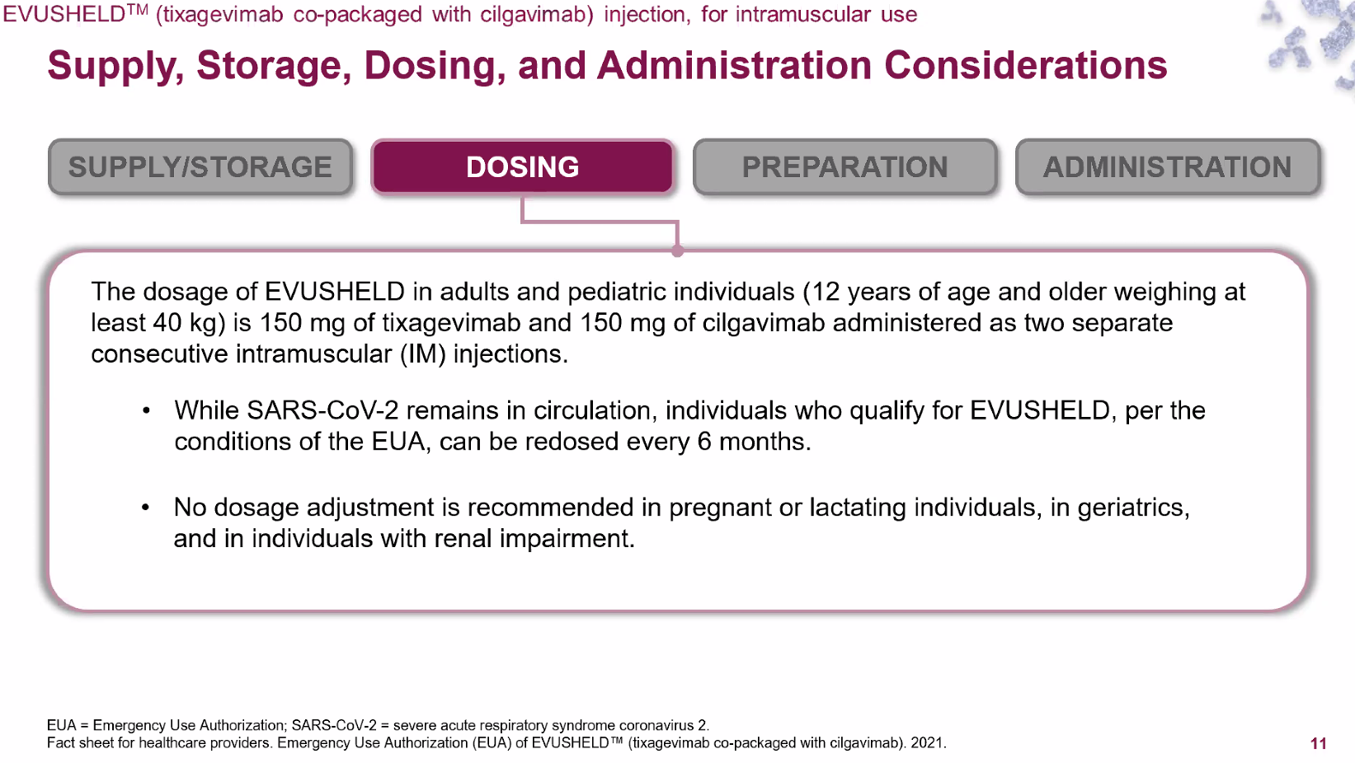
Dosage and Administration

Slide 11
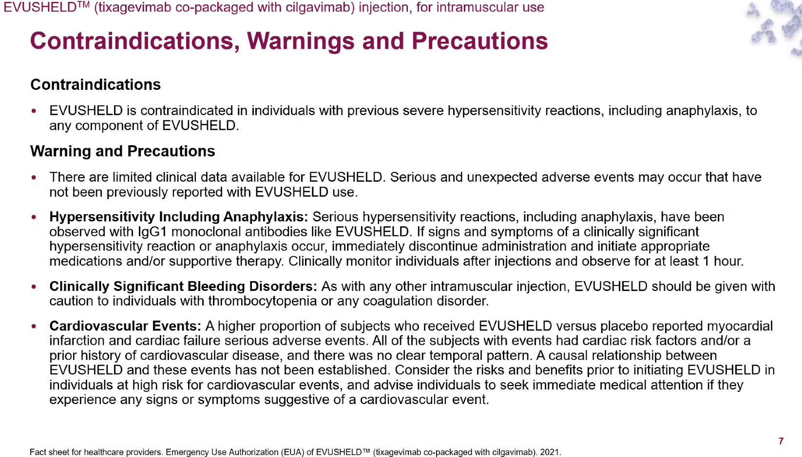
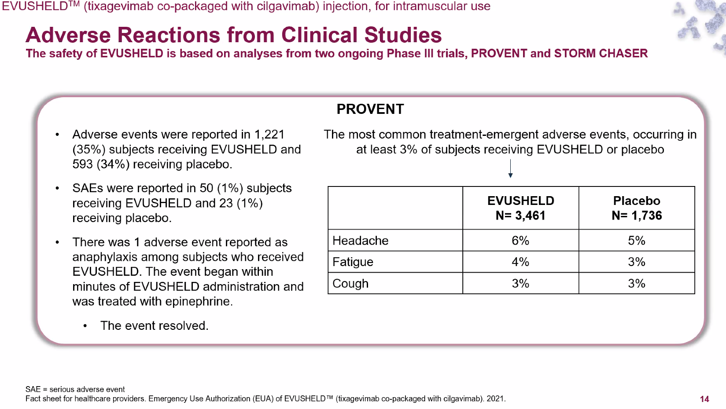
Safety

Slide 12
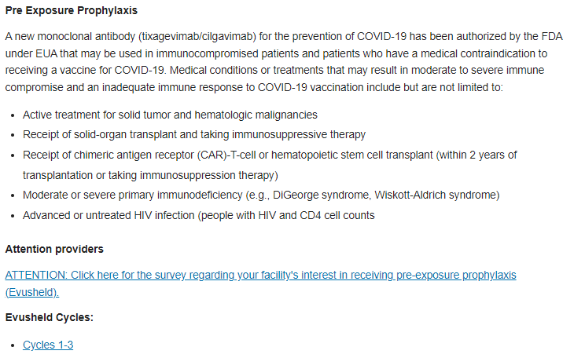
New Sites
https://www.healthy.arkansas.gov/programs-services/topics/covid-19-guidance-on-therapeutics

Slide 13
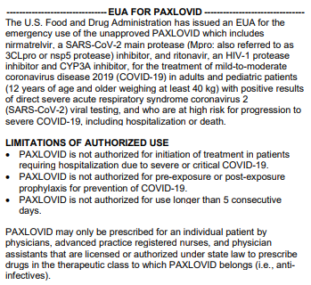
Paxlovid (Nirmatrelavir/Ritonavir)

Slide 14
Dosage and Administration
Nirmatrelavir must be co administered with ritonavir
Within 5 days of symptom onset
Orally with or without food
DO NOT CRUSH
Dosage: 300 mg nirmatrelavir (2 150 mg tablets) with 100 mg ritonavir (1 100 mg tablet); all 3 tabs taken together twice daily for 5 days (30 tabs total)
eGFR 30-60:1 tab nirmatrelavir with1 tab ritonavir, both tabs taken together; twice daily for 5 days (20 tabs total)
Not recommended eGFR<30 or severe hepatic impairment

Slide 15
Adverse Reactions
Hepatotoxicity: Hepatic transaminase elevations, clinical hepatitis, and jaundice have occurred in patients receiving ritonavir.
HIV-1 Drug Resistance: PAXLOVID use may lead to a risk of HIV-1 developing resistance to HIV protease inhibitors in individuals with uncontrolled or undiagnosed HIV-1 infection.
Adverse events were dysgeusia, diarrhea, hypertension, and myalgia.

Slide 16
Drug Interactions
Ritonavir potent CYP3A inhibitor
CYP3A inhibition by ritonavir typically resolves 3-5 days after drug discontinuation
Nirmatrelavir and ritonavir are also substrates of CYP3A, so use with other CYP3A inducers (eg rifampin) may lead to reductions in concentration of active drug

Slide 17
Contraindicated with Paxlovid (not all inclusive)
Amiodarone
Apalutamide
Bosentan
Carbamazepine
Cisapride
Clopidogrel
Clozapine
Colchicine in patients with renal and/or hepatic impairment
Disopyramide
Dofetilide
Dronedarone
Eplerenone
Ergot derivatives
Flecainide
Flibanserin
Glecaprevir/pibrentasvir
Ivabradine
Lumateperone
Lurasidone
Mexiletine
Phenobarbital
Phenytoin
Pimozide
Phenobarbital
Phenytoin
Pimozide
Propafenone
Quinidine
Ranolazine
Rifampin
Rifapentine
Rivaroxaban
Sildenafil for pulmonary hypertension
St. John’s wort
Tadalafil for pulmonary hypertension
Ticagrelor
Vorapaxar
Statement on Paxlovid Drug-Drug Interactions | COVID-19 Treatment Guidelines (nih.gov)
Notes:
Paxlovid is contraindicated with drugs that are
- highly dependent on CYP3A for clearance and
elevated concentration are associate with serious and/or life-threatening reactions.
Yellow

Slide 18
Interactions with Common Drugs (not all inclusive)
Drug Class | Common Drugs Within Class
Anticoagulants | warfarin
 | rivaroxaban
Anticonvulsants | phenytoin phenobarbital
Antidepressants | bupropion
 | trazodone
Antifungals | ketoconazole
 | itraconazole
Antipsychotics | quetiapine
Calcium channel blockers | amlodipine
 | diltiazem
 | nifedipine
Drug Class | Common Drugs Within Class
HMG-CoA reductase inhibitors | atorvastatin
 | simvastatin
Hormonal contraceptive | ethinyl estradiol
Long-acting beta-adrenoceptor agonist | salmeterol
Systemic corticosteroids | betamethasone
 | budesonide
 | dexamethasone
 | fluticasone
 | methylprednisolone
FACT SHEET FOR HEALTHCARE PROVIDERS: EMERGENCY USE AUTHORIZATION FOR PAXLOVID (fda.gov)
Notes:
Paxlovid has interactions with ~30 drug classes and often multiple medications within class

Slide 19
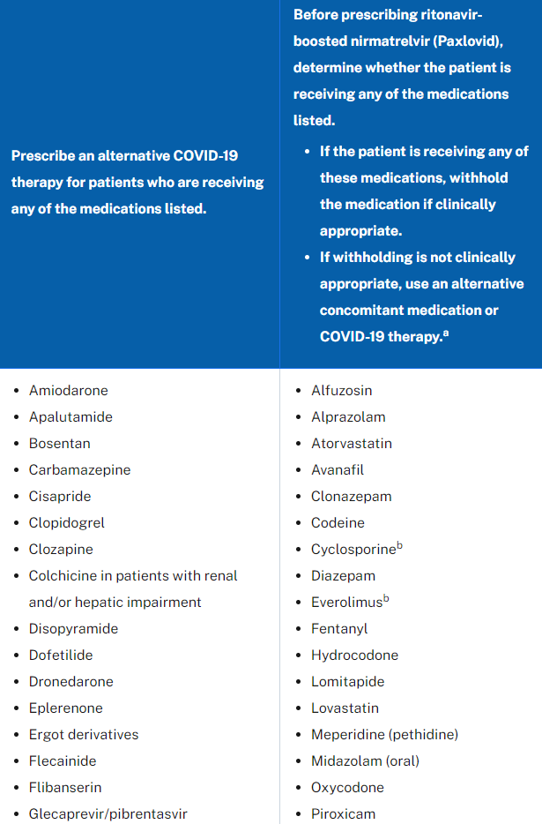
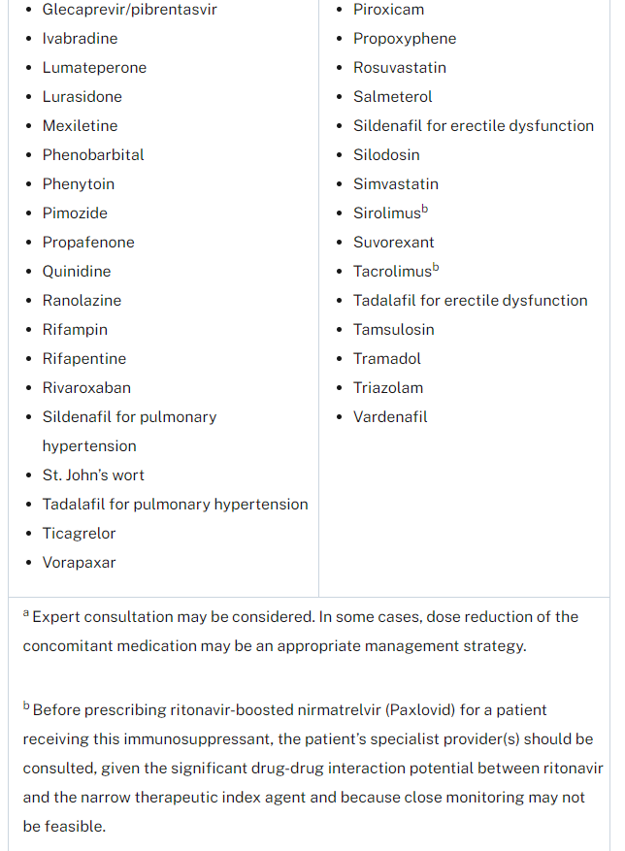
NIH Guidelines Panel Statement Drug Interactions
https://www.covid19treatmentguidelines.nih.gov/therapies/statement-on-paxlovid-drug-drug-interactions/

Slide 20
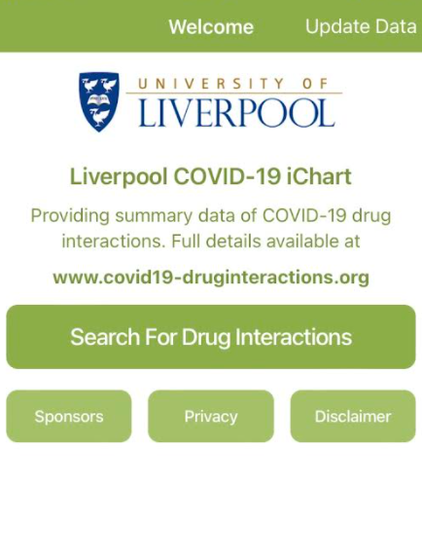
University of Liverpool Interaction Checker
https://www.covid19-druginteractions.org/checker

Slide 21
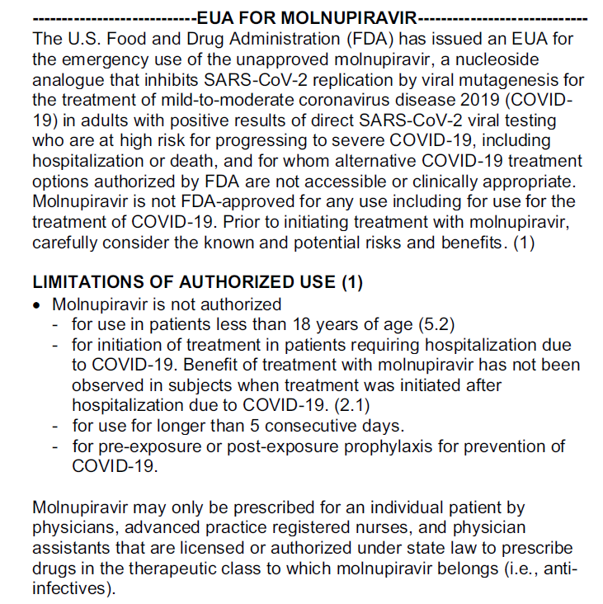
Molnupiravir
Notes:
Molnupiravir is the oral prodrug of beta-D-N4-hydroxycytidine (NHC), a ribonucleoside that has broad antiviral activity against RNA viruses. NHC uptake by viral RNA-dependent RNA-polymerases results in viral mutations and lethal mutagenesis.^{4,5}
Molnupiravir has potent antiviral activity against SARS-CoV-2.⁴ As a mutagenic ribonucleoside antiviral agent, there is a theoretical risk that molnupiravir will be metabolized by the human host cell and incorporated into the host DNA, leading to mutations. Molnupiravir has been evaluated in 2 in vivo rodent mutagenicity assays. One study produced results that were equivocal; in the other study, there was no evidence for mutagenicity. The FDA concluded that, based on the available genotoxicity data and the 5-day duration of treatment, molnupiravir has a low risk for genotoxicity.⁶ In addition, there have been concerns about the potential effects of molnupiravir on SARS-CoV-2 mutation rates; the FDA is requiring the manufacturer to establish a process to monitor genomic databases for the emergence of SARS-CoV-2 variants.

Slide 22
Dosage And Administration
800 mg (4 200 mg capsules) orally twice daily for 5 days (40 capsules)
Within 5 days of symptom onset
Orally with or without food

Slide 23
Special Considerations
Embryo-Fetal Toxicity: not recommended for use during pregnancy
Bone and Cartilage Toxicity: not authorized for younger than 18 years of age because of this concern
Most common adverse reactions: diarrhea, nausea and dizziness
Pregnancy: The use of molnupiravir is not recommended during pregnancy. Advise individuals of childbearing potential to use effective contraception correctly and consistently, as applicable, for the duration of treatment and for 4 days after the last dose of molnupiravir.
Lactation: Breastfeeding is not recommended during treatment and for 4 days after the last dose of molnupiravir. A lactating individual may consider interrupting breastfeeding and may consider pumping and discarding breast milk during
Notes:
Molnupiravir is the oral prodrug of beta-D-N4-hydroxycytidine (NHC), a ribonucleoside that has broad antiviral activity against RNA viruses. NHC uptake by viral RNA-dependent RNA-polymerases results in viral mutations and lethal mutagenesis.^{4,5}
Molnupiravir has potent antiviral activity against SARS-CoV-2.⁴ As a mutagenic ribonucleoside antiviral agent, there is a theoretical risk that molnupiravir will be metabolized by the human host cell and incorporated into the host DNA, leading to mutations. Molnupiravir has been evaluated in 2 in vivo rodent mutagenicity assays. One study produced results that were equivocal; in the other study, there was no evidence for mutagenicity. The FDA concluded that, based on the available genotoxicity data and the 5-day duration of treatment, molnupiravir has a low risk for genotoxicity.⁶ In addition, there have been concerns about the potential effects of molnupiravir on SARS-CoV-2 mutation rates; the FDA is requiring the manufacturer to establish a process to monitor genomic databases for the emergence of SARS-CoV-2 variants.

Slide 24
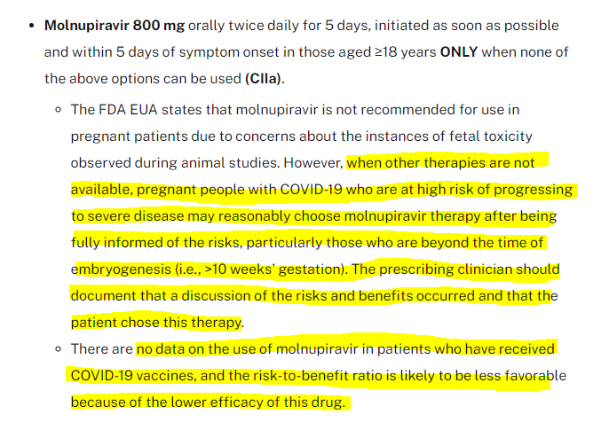
NIH Statement

Slide 25
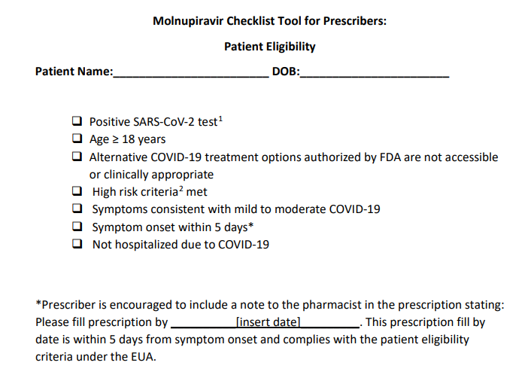
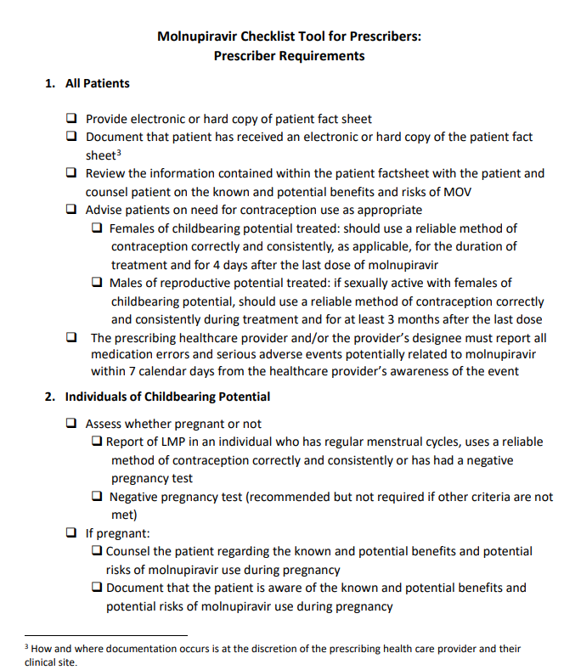
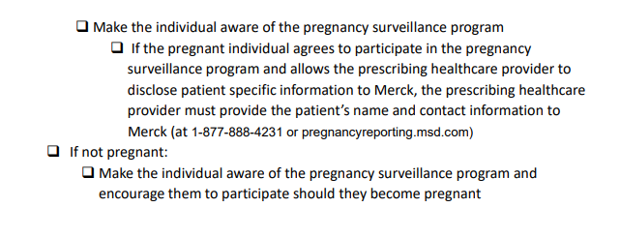
Molnupiravir Prescriber Checklist
https://www.healthy.arkansas.gov/images/uploads/pdf/EUA_108_Merck_Molnupiravir_Prescriber_Checklist_(12232021).pdf

Slide 26
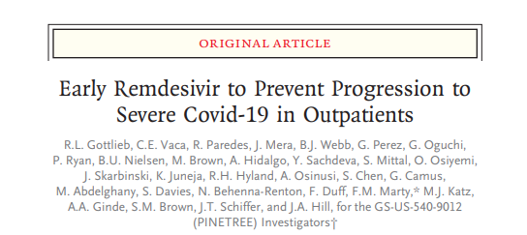
PINETREE
Unvaccinated patients with confirmed SARS COV2 infection randomized to 3 days of remdesivir or placebo within 7 days of infection
Hospitalization or death decreased by 87% in treatment (2 vs 15); equates to 47 fewer hospitalizations per 1000 infections
Caveats: data limited to unvaccinated individuals, no significant decrease in viral loads
Paxlovid and molnupiravir trials also excluded vaccinated individuals, viral loads not reported in EUA

Slide 27
Activity of COVID 19 Therapeutics
 | Pseudovirus Neutralization FOLD Reduction in Susceptibility |  | Prevention of Hospitalization/Death in trial data Assuming 100% Efficacy
 | Delta | Omicron | Treatment Arm | Placebo Arm | RR Reduction
Bam/Ete | No change | >2938 fold | 4/511 | 15/258 | 87%×
Regen CoV | No change | >1013 fold | 7/736 | 24/748 | 70%×
Sotrovimab | No change | No change | 6/528 | 30/529 | 79%
Evusheld (pre exposure) | No change | 132-183 fold Live virus 12-30 | 8/3441 | 17/1731 | 77%
Evusheld* (treatment, not EUA) |  |  | 18/407 | 37/415 | 50%
Paxlovid | No change | No data | 8/1039 | 66/1046 | 88%
Molnupiravir | No change | No data | 49/709 | 77/699 | 30%
Remdesivir | No data | No data | 2/279 | 15/283 | 87%

Slide 28
NIH Treatment Recommendations (listed in order of preference)
Paxlovid 300/100 BiDx 5 days, within 5 days, >12 years and >40 kg
Sotrivimab single dose IV within 10 days, >12 yrs and >40 kg
  If using SGTF or if delta is significant or if no other options available, can use bam/ete and Regen CoV understanding it would be ineffective with Omicron
Remdesivir 200 iv day 1, then 100 iv days 2, 3 within 7 days, >12 yr and >40 kg
  Off label use
Molnupiravir 800 bidx5 days, within 5 days, >18 yr
  Not recommended for pregnant patients, however if other therapies are not available, risk vs benefit esp >10 weeks gestation

Slide 29
Monoclonal Supply: Jan 2022

Slide 30
Oral Antivirals Supply: Jan 2022

Slide 31
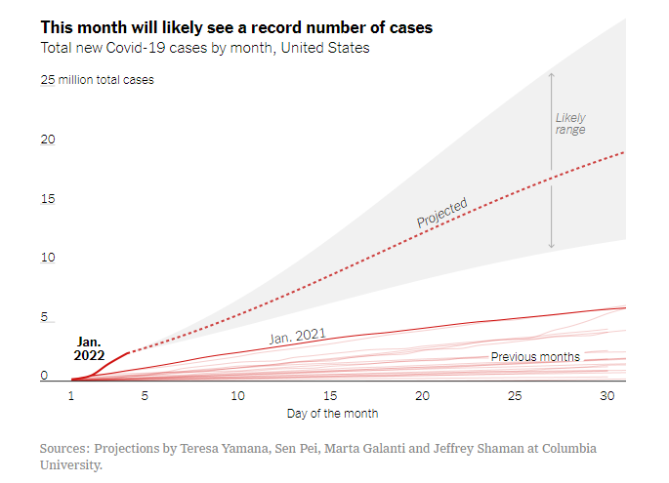
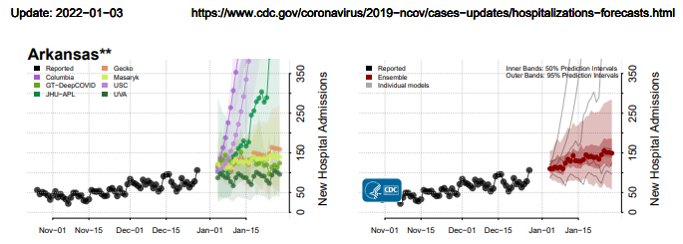
New Cases and Hospitalization Forecast Models

Slide 32
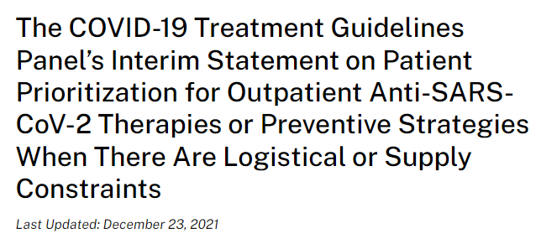
With the increase in cases of COVID-19 and the emergence of the Omicron (B.1.1.529) variant of concern, there may be logistical or supply constraints that make it impossible to offer the available therapy to all eligible patients, making patient triage necessary.

Slide 33
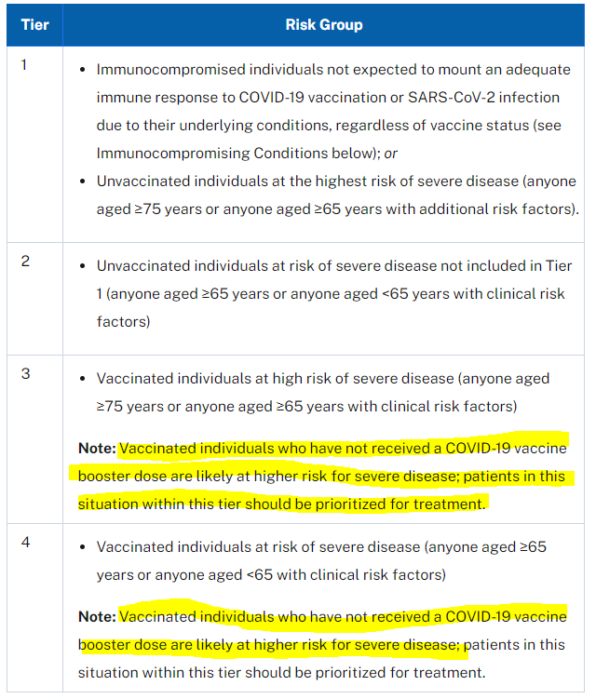
NIH Recommendations
Key Elements for Prioritizations:
Age
Vaccination
Immune Status
Clinical Risk Factors
https://www.covid19treatmentguidelines.nih.gov/therapies/statement-on-patient-prioritization-for-outpatient-therapies/

Slide 34
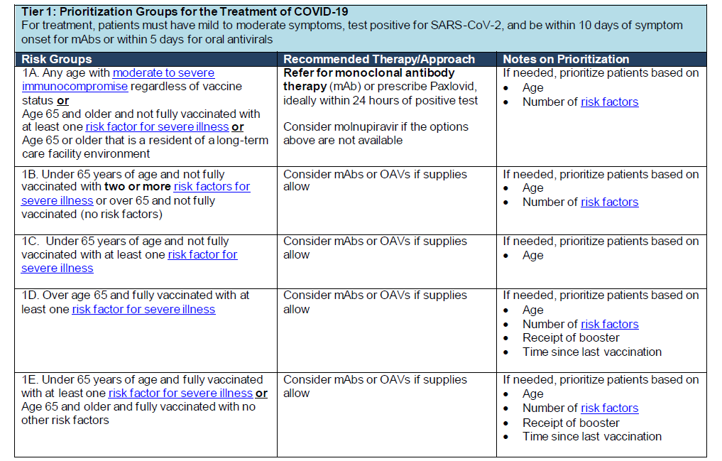
Prioritization Algorithm
https://coronavirus.health.ny.gov/system/files/documents/2021/12/prioritization_of_mabs_during_resource_shortages_20211229.pdf

Slide 35
COVID 19 Therapeutics
Allocation Program

Slide 36
Therapeutic Allocation
CYLCE | BAM/ETE | REGEN-COV | SOTROVIMAB | TOTAL DISTRIBUTION
CYCLE 14 (01/10/22) ALLOCATION | 360 | 444 | 402 | 1,206
Allocation Formula
Based on active cases per 10K
Ensure all (5) PH Regions have treatment available

Slide 37
Oral Antivirals
Paxlovid (Pfizer) Allocation
Initial allocation for AR: 740 doses (1/10/22)
320 courses of treatment was transferred to Walmart for distribution to the (5) Public Health Regions
Number of Walmart Stores:
  (6) Central
  (4) Northwest
  (3) Northeast
  (2) Southwest
  (1) Southeast
220 courses of treatment was transferred to Community Pharmacy Enhanced Services Network – Arkansas (AR CPESN) for distribution to the (5) Public Health Regions
The remaining 200 courses
  allocated sites throughout Public Health Region
  Long-term Care Facilities

Slide 38
Oral Antivirals
Molnupiravir (Merck)
Allocation: 2,940 courses of treatment 1/10/22
  Walmart: 500 courses of treatment for distribution to all (5) PH Regions
  AR CPESN: 1,000 courses of treatment for distribution to all (5) PH Regions
HPOP account validation ongoing/expanding program to include additional sites
Added to ADH’s Therapeutic webpage

Slide 39
Pre-Exposure Prophylaxis
AstraZeneca’s EVUSHELD
648 (1/10/22)
Initial Sites:
  UAMS
  Baptist Health (LR)
  Washington Regional
  St. Bernard’s
  NEA Baptist
  Arkansas Heart Hospital
  Highland Oncology
  ** added 10 additional sites**

Slide 40
Therapeutic Update
Allocation Concerns
  Critical allocation shortage ** >3,100 requests allocated 1,206 doses (402 Sotrovimab)**
  Next Allocation 1/17/22: BAM/ETE, REGEN-COV, Sotrovimab, and EVUSHELD
ASPR’s COVID Therapeutic Locator *live* https://covid-19-therapeutics-locator-dhhs.hub.arcgis.com/
  Added to ADH therapeutic page
  Real time update: EVUSHELD, Molnupiravir and Paxlovid
Outreach:
  Prioritization updates
  Weekly zoom calls with all administration sites

Slide 41
Therapeutics Locator
https://covid-19-therapeutics-locator-dhhs.hub.arcgis.com/
https://www.healthy.arkansas.gov/programs-services/topics/covid-19-guidance-on-therapeutics

Slide 42






Public Health Partnerships

Slide 43
Thanks: The A Team
Preparedness Communications Epi and GIS
Darla Dal Santo Katie White Tara Barsotti
Steele Kelley Patrick Fleming Scott Alsbrook
Christie Walls

